Slide 1
Analytics 2.0?

Slide 2
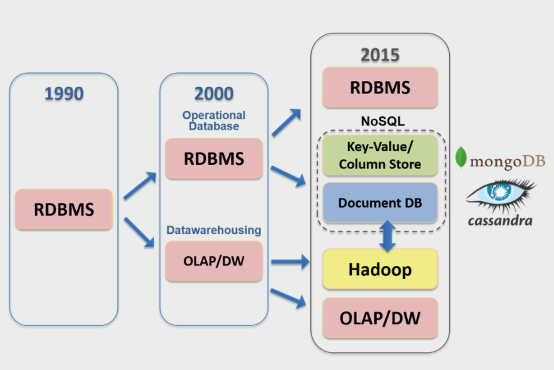

Slide 3
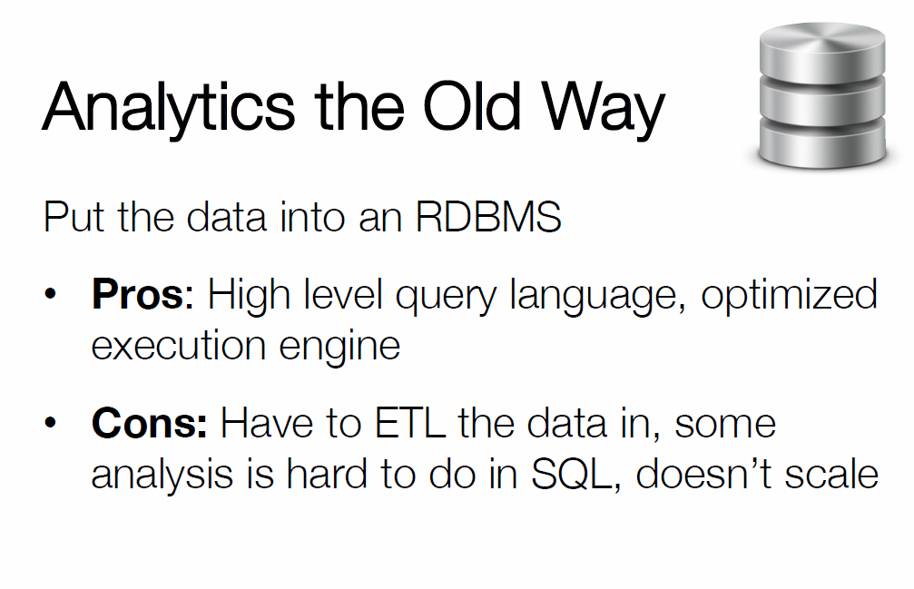

Slide 4
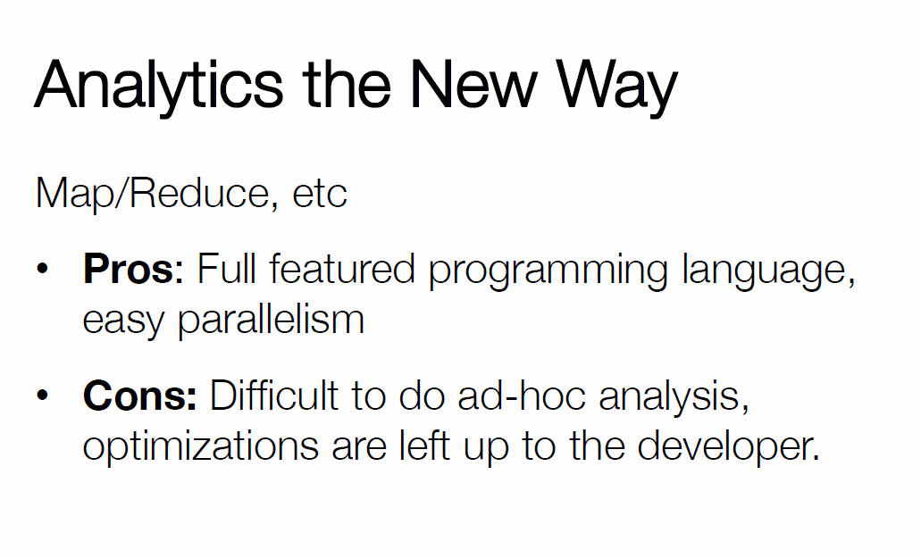

Slide 5
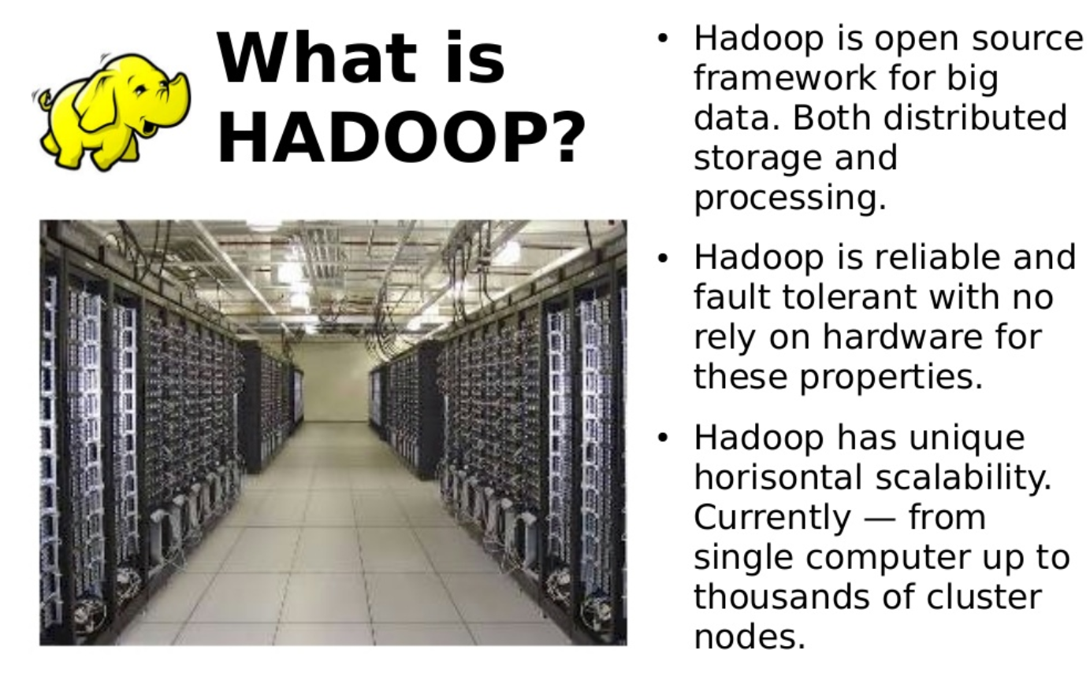

Slide 6
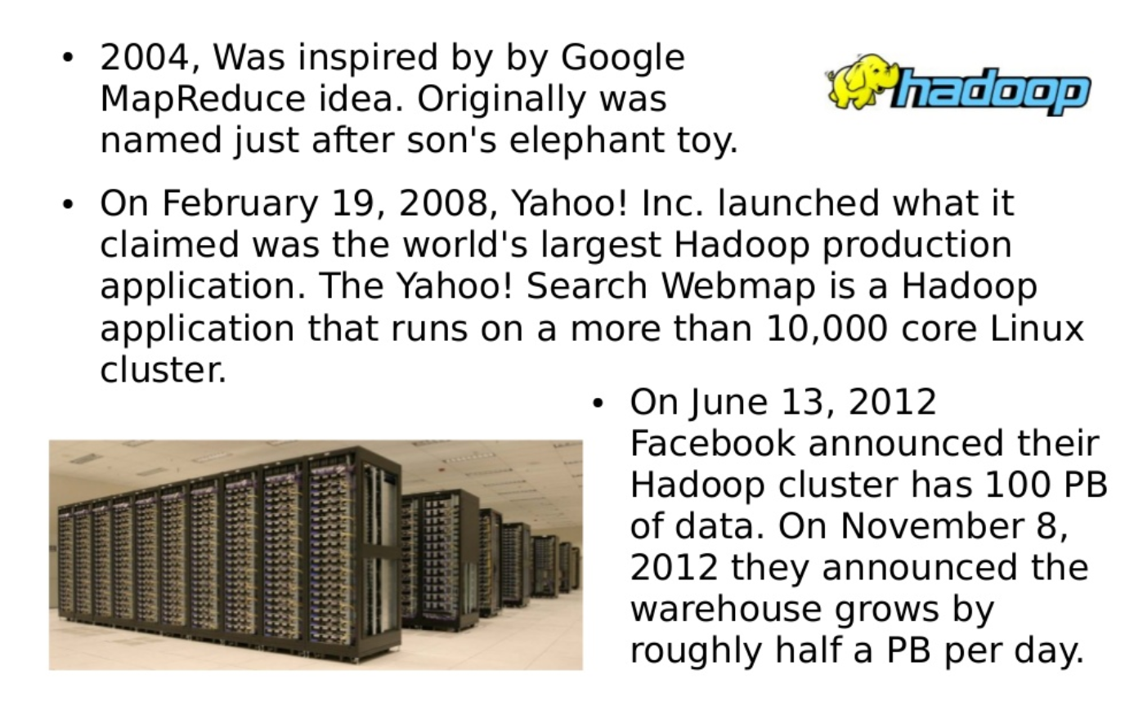

Slide 7
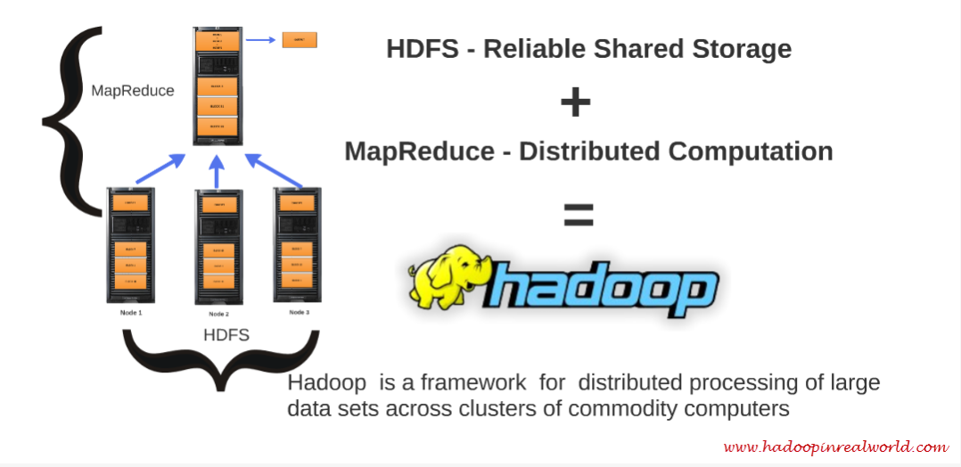
Hadoop

Slide 8
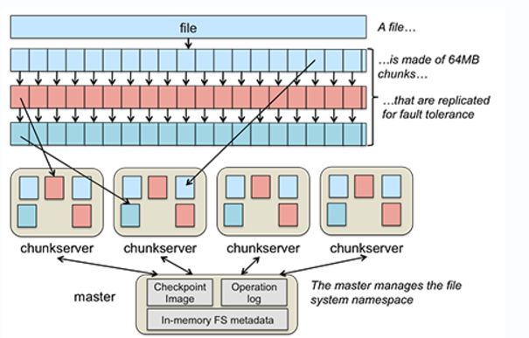
Hadoop: File Splits into Multi-Segment

Slide 9
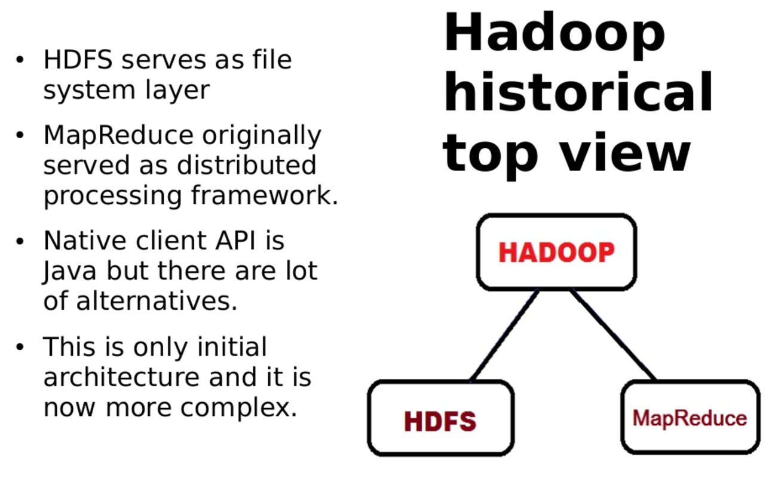

Slide 10
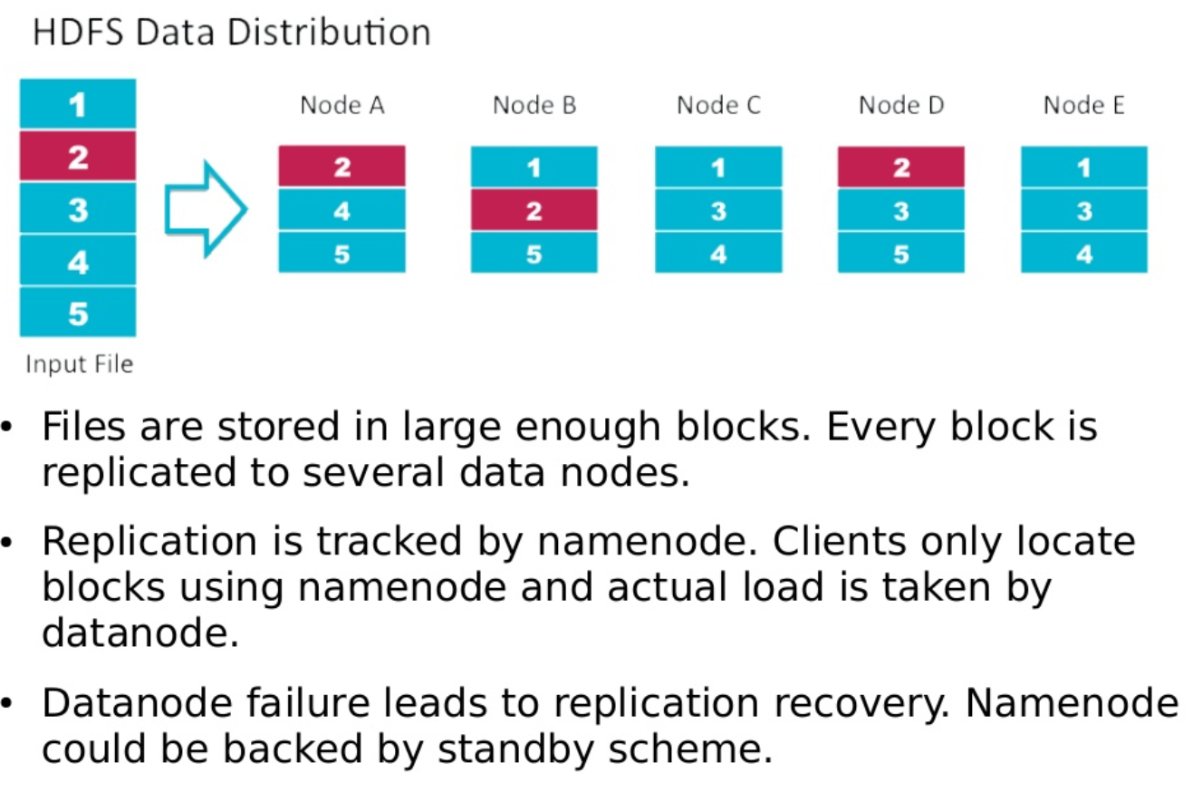

Slide 11
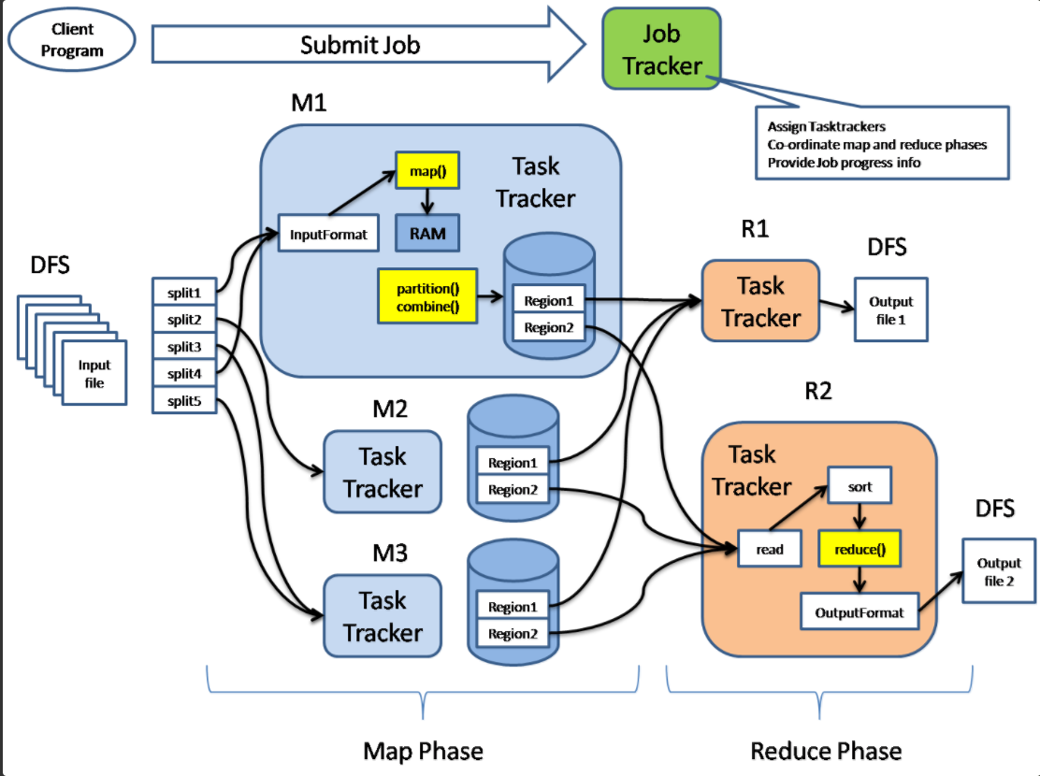

Slide 12
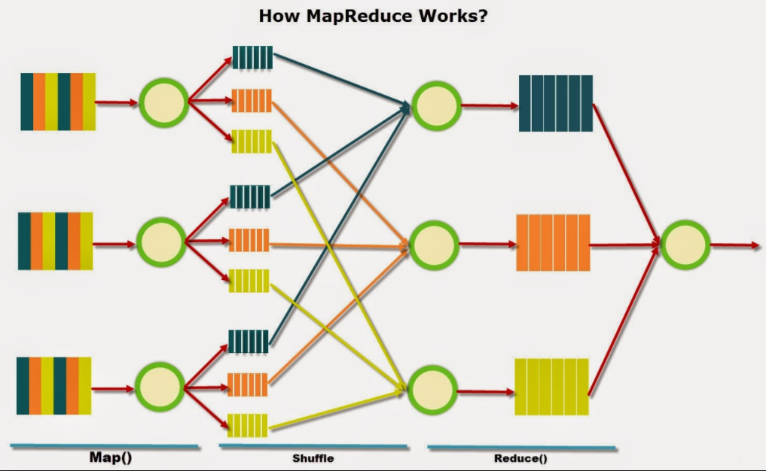

Slide 13
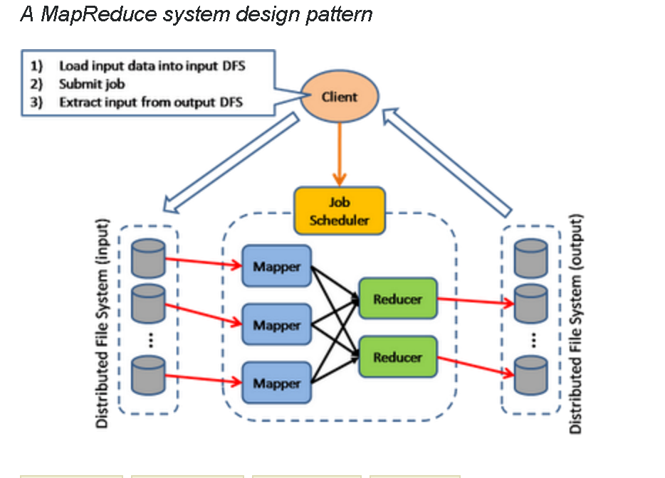

Slide 14
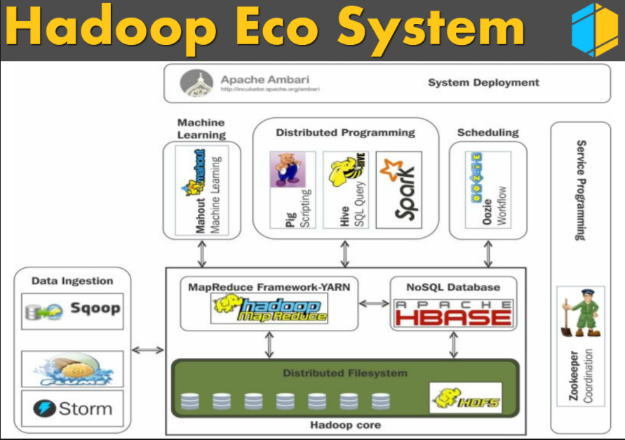

Slide 15


What is Apache Spark?
Fast and general cluster computing system, interoperable with Hadoop, included in all major distros
Improves efficiency through:
In-memory computing primitives
General computation graphs
Improves usability through:
Rich APIs in Scala, Java, Python
Interactive shell
Up to 100× faster
(2-10× on disk)
2-5× less code

Slide 16
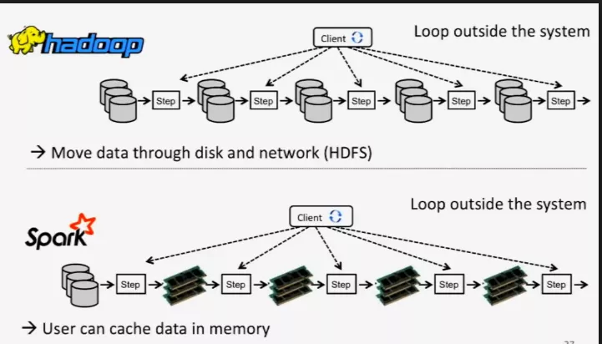

Slide 17
Spark Model
Write programs in terms of transformations on distributed datasets
Resilient Distributed Datasets (RDDs)
Collections of objects that can be stored in memory or disk across a cluster
Parallel functional transformations (map, filter, …)
Automatically rebuilt on failure

Slide 18
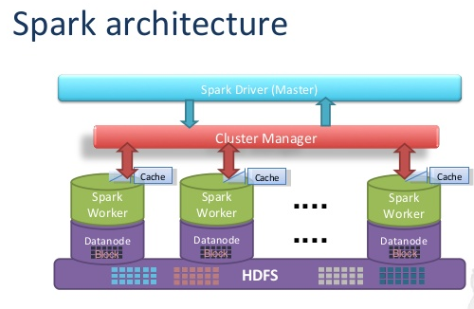

Slide 19
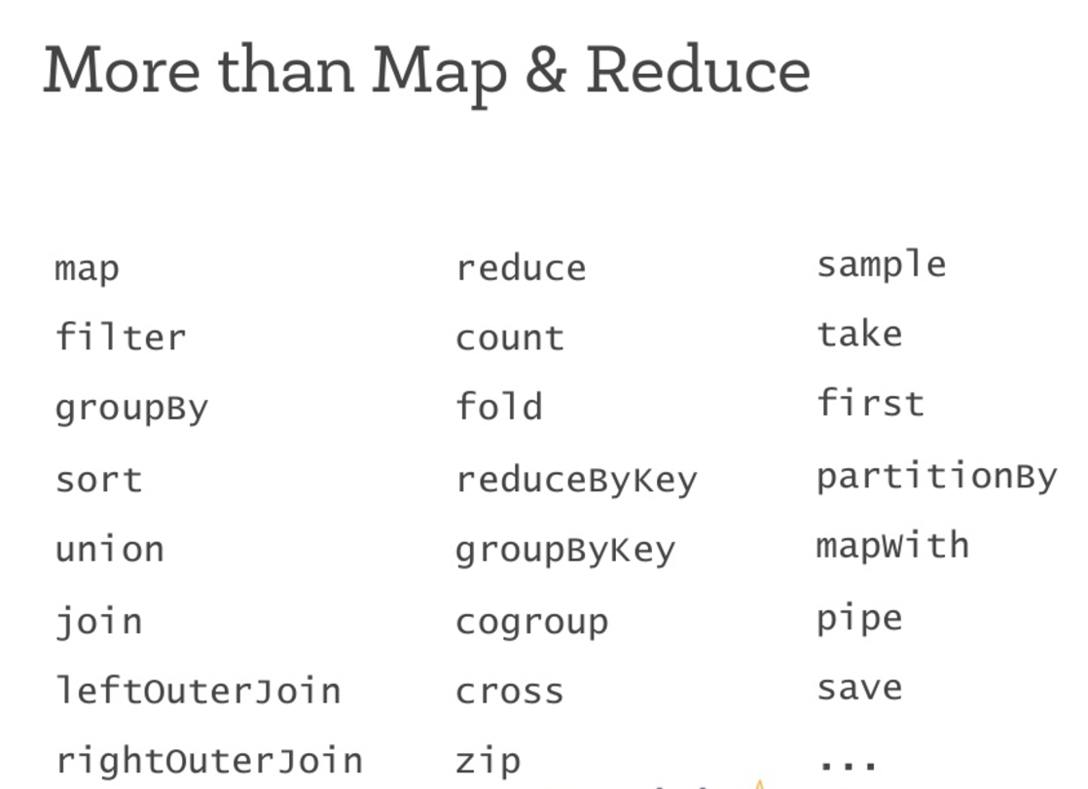

Slide 20
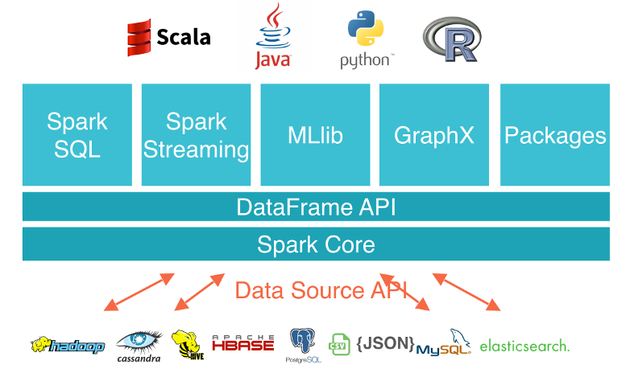

Slide 21
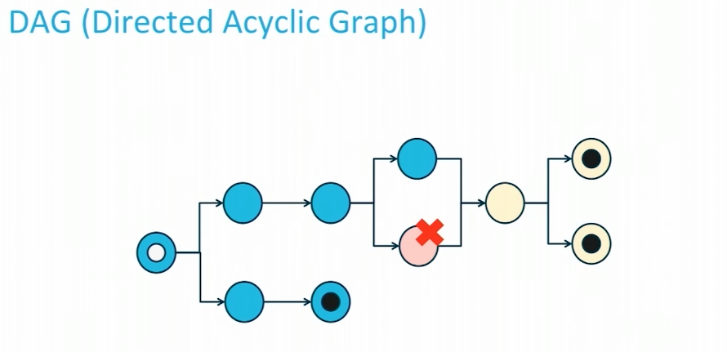
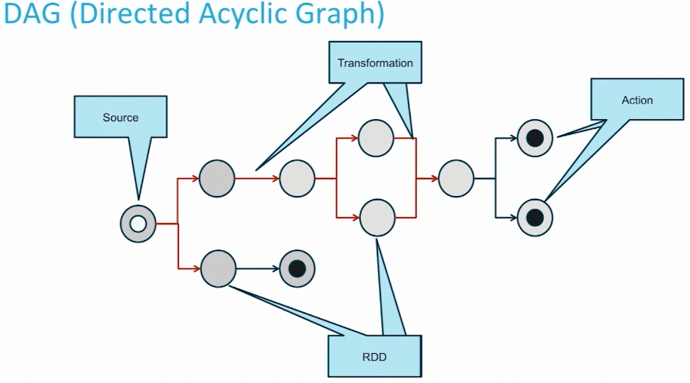
Spark Task Scheduling
DAG engine supports and optimizes cyclic data flows, and carry out in-memory cluster computing
DAG are used to structure the execution of a job and keep the lineage of the RDDs involved
In case of failure only the non-available parent RDDs are recursively computed
DAG structures the job into stages
Each stage is a set of independent tasks all computing the same function
The split is done at shuffling boundaries
Spark Scheduler can run stages in the proper order

Slide 22
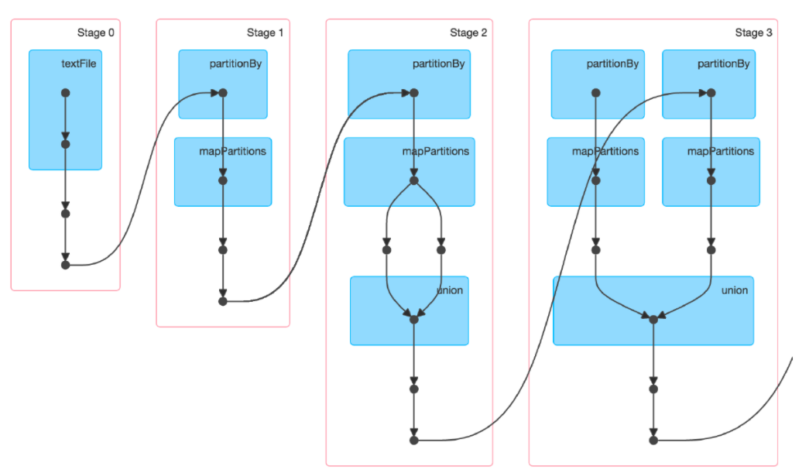

Slide 23


On-Disk Sort Record: Time to sort 100TB
2013 Record: Hadoop
2100 machines
72 minutes
2014 Record: Spark
207 machines
23 minutes
Also sorted 1PB in 4 hours
Source: Daytona GraySort benchmark, sortbenchmark.org
23

Slide 24
Powerful Stack – Agile Development
Your fancy
SIGMOD technique
here
GraphX
SparkSQL
Streaming
non-test, non-example source lines

Slide 25

: Declarative Big Data Processing
SQL
Let Developers Create and Run Spark Programs Faster:
Write less code
Read less data
Let the optimizer do the hard work
25

Slide 26
DataFrame
A distributed collection of rows organized into named columns.
An abstraction for selecting, filtering, aggregating and plotting structured

Slide 27
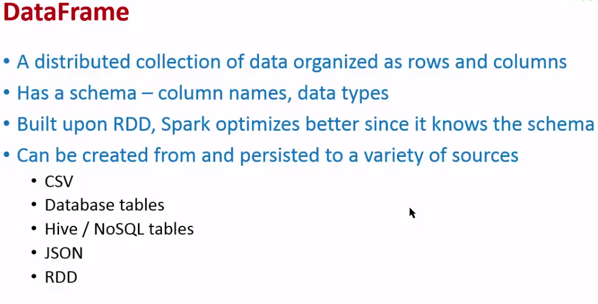
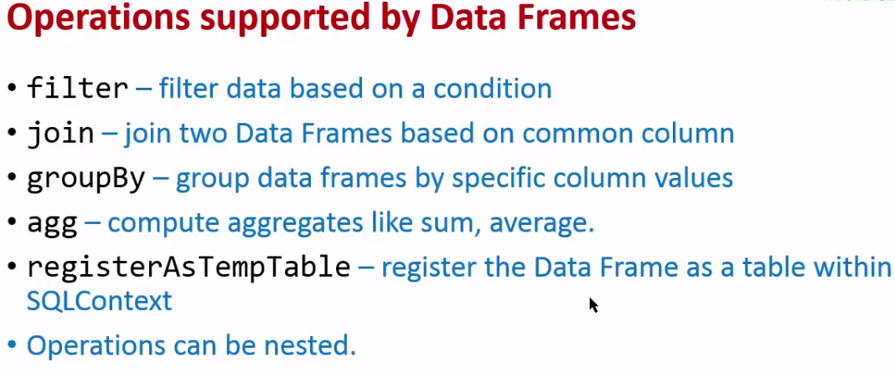

Slide 28
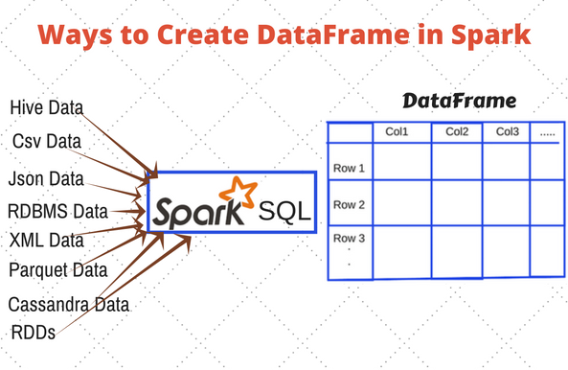

Slide 29
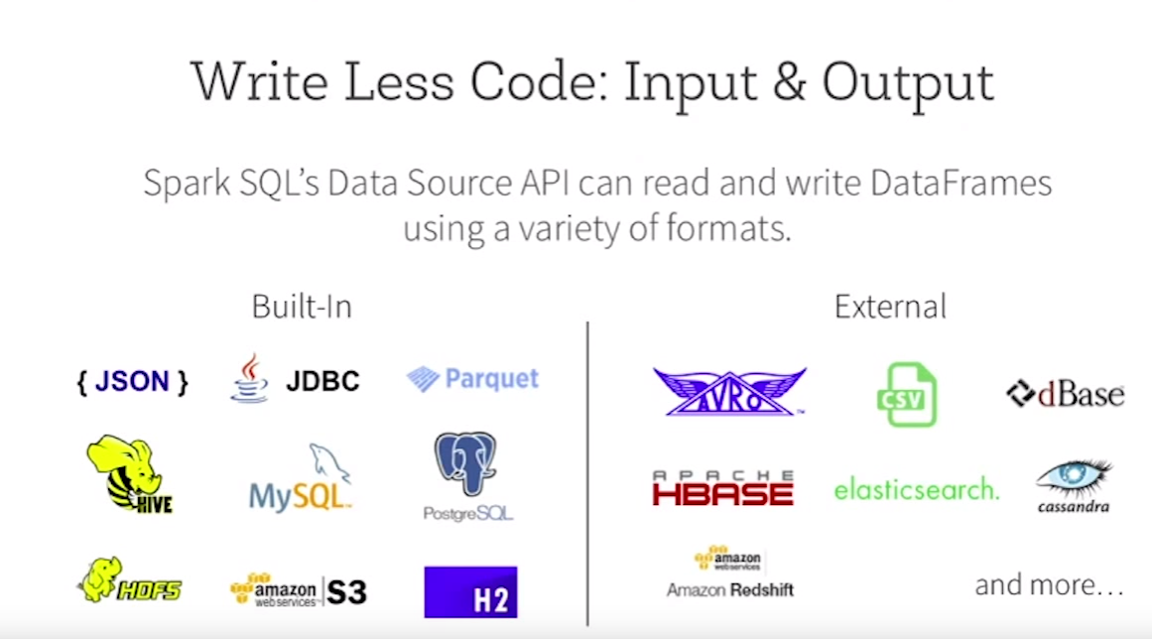

Slide 30

Write Less Code: Compute an Average
private IntWritable one =
new IntWritable(1)
private IntWritable output =
new IntWritable()
proctected void map(
LongWritable key,
Text value,
Context context) {
String[] fields = value.split("\t")
output.set(Integer.parseInt(fields[1]))
context.write(one, output)
}
IntWritable one = new IntWritable(1)
DoubleWritable average = new DoubleWritable()
protected void reduce(
IntWritable key,
Iterable<IntWritable> values,
Context context) {
int sum = 0
int count = 0
for(IntWritable value : values) {
sum += value.get()
count++
}
average.set(sum / (double) count)
context.Write(key, average)
}
data = sc.textFile(...).split("\t")
data.map(lambda x: (x[0], [x.[1], 1])) \
.reduceByKey(lambda x, y: [x[0] + y[0], x[1] + y[1]]) \
.map(lambda x: [x[0], x[1][0] / x[1][1]]) \
.collect()

Slide 31
Write Less Code: Compute an Average
Using RDDs
data = sc.textFile(...).split("\t")
data.map(lambda x: (x[0], [int(x[1]), 1])) \
.reduceByKey(lambda x, y: [x[0] + y[0], x[1] + y[1]]) \
.map(lambda x: [x[0], x[1][0] / x[1][1]]) \
.collect()
Using SQL
SELECT name, avg(age)
FROM people
GROUP BY name
Using Pig
P = load '/people' as (name, name);
G = group P by name;
R = foreach G generate … AVG(G.age);
Using DataFrames
sqlCtx.table("people") \
.groupBy("name") \
.agg("name", avg("age")) \
.collect()
31

Slide 32
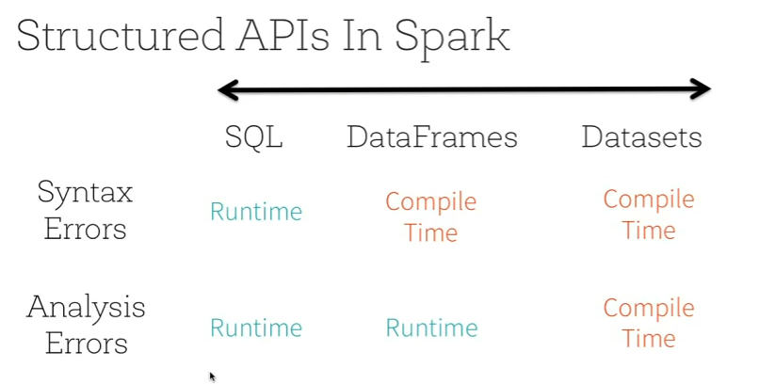

Slide 33
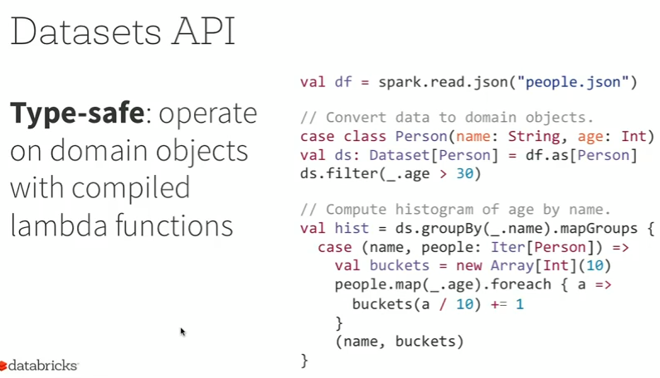

Slide 34
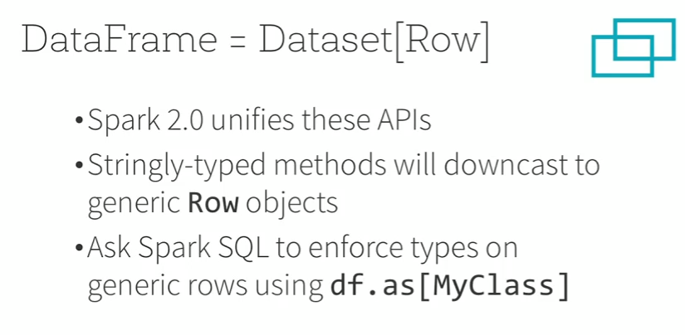

Slide 35
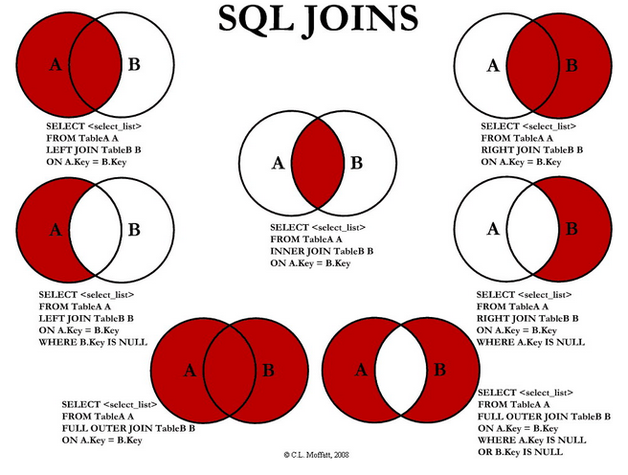

Slide 36
Demo POC

Slide 37
Demo POC
Generate test data (members, provider, claim)
ETL (dynamically validation)
Create Small Dataset (PII-Personally identifiable information and PHI-Protected Health information)
Batch & Real-time(Stream) process
Deploy and Execute?
Technologies (Spark, Cassandra, Kafka, .NET WebApi)
Languages (Scala, Java, CQL, C#)
DB Storage(text file, Cassandra, SQL server)
(Fast, Scale-out, Open-Source, Cost Saving and development and Deployment )

